Slide 1
Projektarbeit Roboterprogrammierung
Proximal Policy Optimization (PPO) for Continuous Action Spaces
Robin Wolf, Mathias Fuhrer 16.01.2024

Slide 2
PPO - Proximal Policy Optimization
experience gathering
environment
Store episode/ epoch data: s_{t} a_{t} R_{t} s_{t+1} terminal_{t}
s_{t}
a_{t}
s_{t} a_{t}
s_{t} a_{t}
s_{t}
s_{t+1}
s_{t}
π_{φ}
π_{old}
c_{θ}
c_{target}
update weights
after every
epoch
update
weights periodically
calculate ratio
calculate advantage
update
update
loss_{actor} = -r_{φ}(s_{t}, a_{t})·adv_{θ}(s_{t}, a_{t})
loss_{critic} = MSE(adv_{θ}(s_{t}, a_{t}))
actor network
→ policy π_{φ} training
critic network
→ values c_{θ} training
Notes:
Actor Net:
Enthält Policy → in welchem action sollte in diesem state am besten ausgeführt werden
Ratio → aktuelle durch alte policy für diesen state und action π_{φ}(a_{t} | s_{t}) / π_{φ´}(a_{t} | s_{t}) → ist größer 1 wenn aktuelle policy die action im aktuellen state als wahrscheinlicher bewertet
Critc Net:
Schätzt Value → gibt an, wie vorteilhaft oder nachteilhaft es ist, sich in einem bestimmten Zustand zu befinden
Advantage → Differenz zwischen dem tatsächlichen Reward einer Aktion in einem Zustand und dem erwarteten Wert dieses Zustands darstellt

Slide 3
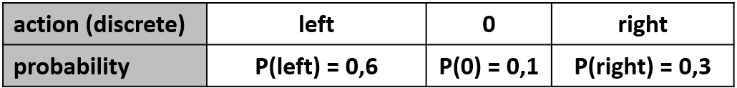
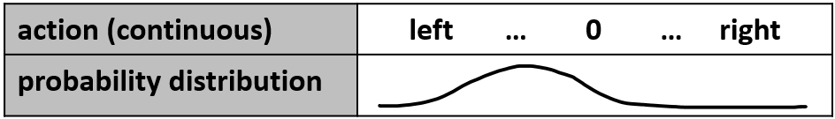
Discrete vs. continuous actionspace
discrete | continuous
A probability is calculated for each discrete action → Actor-Net has an output for every discrete action | An action probability distribution is calculated for each “degree of freedom” Actor-Net has two outputs for each “degree of freedom” (mean and standard deviation)
main changes in the implementation:
actor network
act method → how to sample actions to explore the enviroment
learn method → get_actor_gradients/ sampeling actions to calculate actor loss

Slide 4
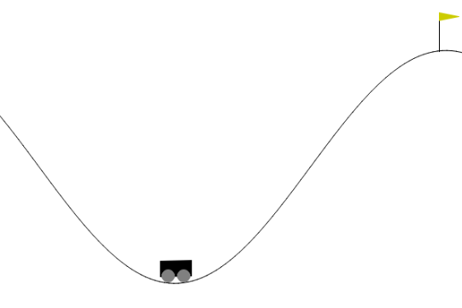

Mountain Car Environment
Discrete:
Observation Space (2 dimensional):
position of the car along the x-axis [-1,2 … 0,6]
velocity of the car [-0,7 … 0,7]
Action Space (3 dimensional):
0: Accelerate to the left
1: Don’t accelerate
2: Accelerate to the right
Length of one episode is 200 steps
Continuous:
Observation Space (2 dimensional):
position of the car along the x-axis [-Inf … Inf]
velocity of the car [-Inf … Inf]
Action Space (1 dimensional):
force applied to the car [-1 … 1]
Length of one episode is 999 steps
https://gymnasium.farama.org/environments/classic_control/mountain_car/
https://gymnasium.farama.org/environments/classic_control/mountain_car_continuous/
Abgerufen am 12.01.2024

Slide 5
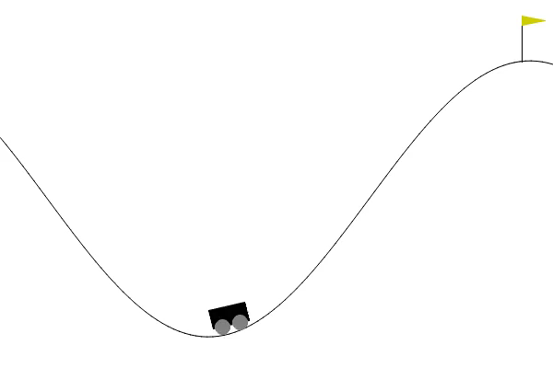
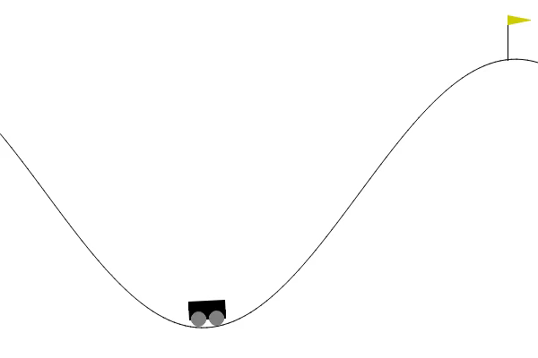
After training in the original environments …
discrete
continuous
Discrete: negative reward of -1 at each timestep
Continuous: negative reward of -0.1 * action² at each timestep, positive reward of +100 added if the car reaches the goal
→ Unlikely that car will make it into the goal by chance → reward shaping

Slide 6
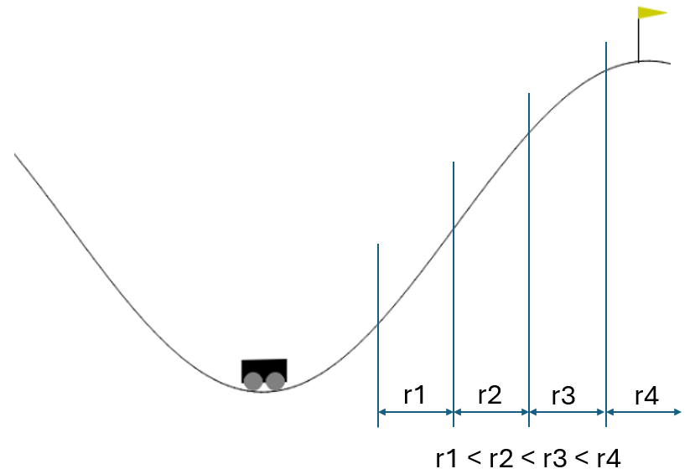
Reward shaping
Attempt 1: position
Attempt 2: velocity
→ reward is higher when velocity is higher

Slide 7

After reward shaping
Position-based reward attempt was unsuccessful
tries to drive up the right hill without gaining momentum on the left hill
to get up the mountain, the agent would have to accept a temporarily worse reward
→ remains at a local (reward) maximum

Slide 8
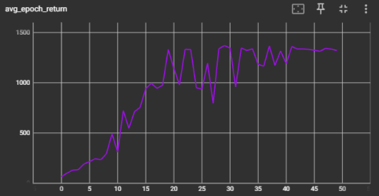
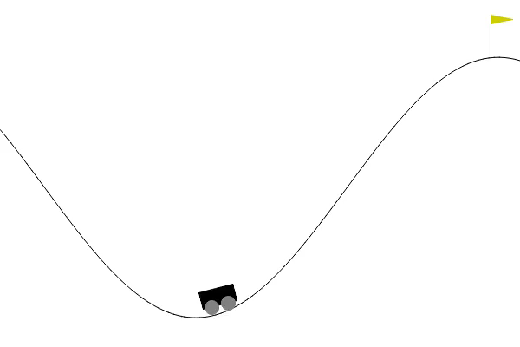
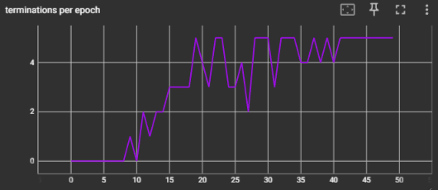
After reward shaping
Velocity-based reward attempt was successful (in discrete and continuous action space)
Average epoch return:
Terminations per epoch (one epoch has 5 episodes):
Notes:
CustomMountainCarEnv_acceleration_discrete_20240111_085352
Training:
Continuous: ca 800min = 13h 20min
Discrete: ca. 150min = 2h 30min

Slide 9
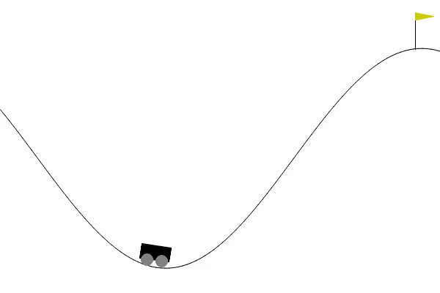
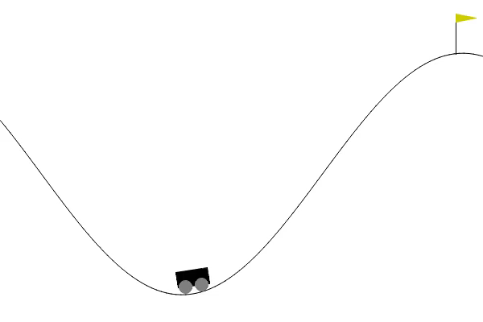
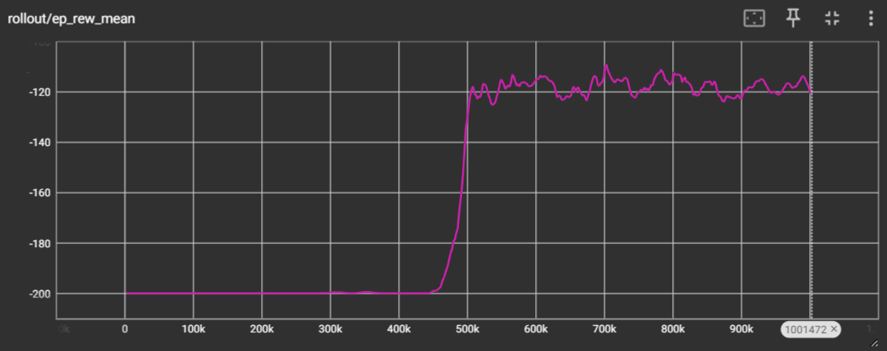
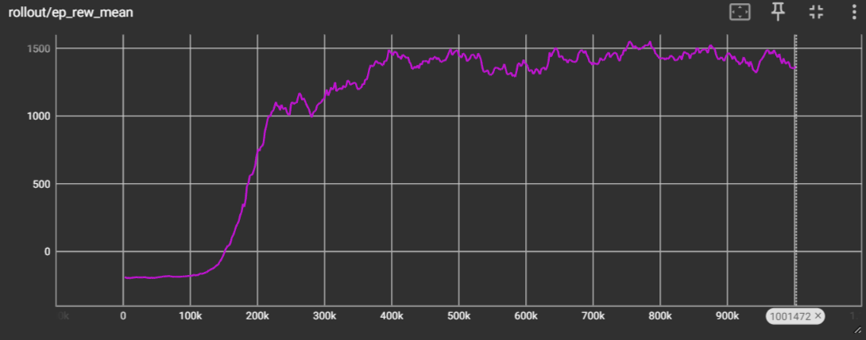
Discrete Mountain Car with stable baselines3
Standard environment without reward shaping
environment with reward shaping
Works well if goal is reached once, but needs lot of training steps
only velocity attempt terminates
faster learning at nearly equal performance
default parameters from BaselinesZoo (by DLR) were used
Notes:
Training time < 60 min for 1Mio steps

Slide 10

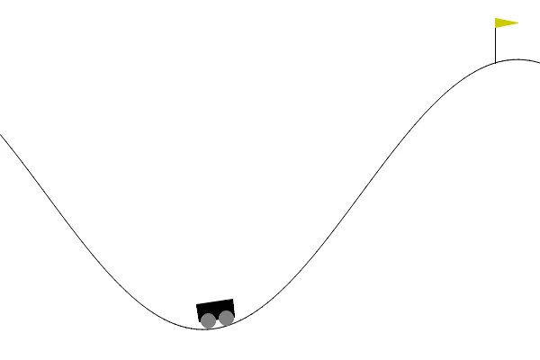
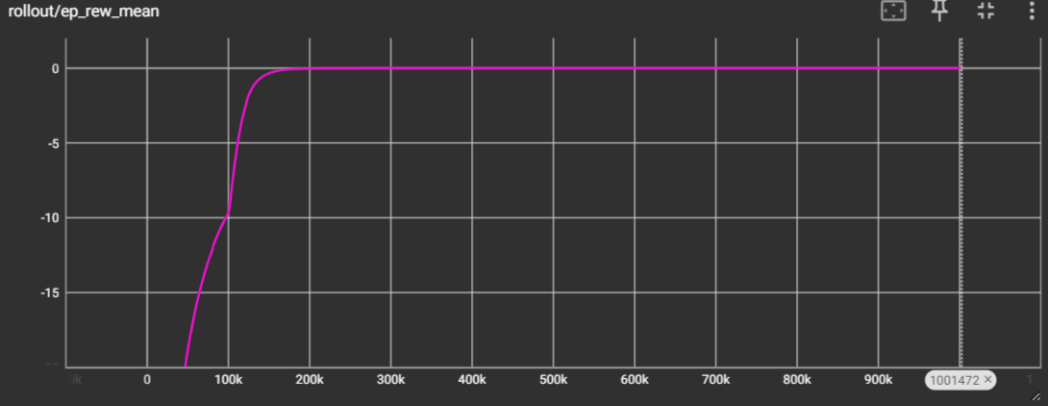
Continuous Mountain Car with stable baselines3
Standard environment without reward shaping
environment with reward shaping
Agent learns to do nothing
Doesn‘t explore the positive reward at goal
Local loss minimum at reward = 0
Only velocity attempt terminates
Needs more attempts to reach goal in comparison to the discrete agent
Balance between positive and negative rewards
default parameters from BaselinesZoo (by DLR) were used
Notes:
Training <90min for 1 Mio Steps.

Slide 11
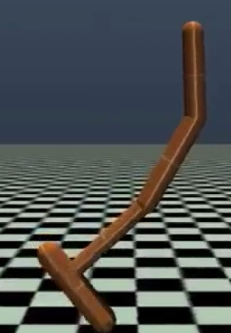
Hopper Environment
Part of the MUJOCO environments → physics engine for multi joint control in robotics
Observation Space (11 dimensional):
Height of the hopper [-Inf … Inf]
Angle of all joints and the top [-Inf … Inf]
Angular velocity of all joints and the top [-Inf … Inf]
Velocity of the top in X and Z of the world [-Inf … Inf]
Action Space (3 dimensional):
torque applied to the top joint [-1 … 1]
torque applied to the leg joint [-1 … 1]
torque applied to the foot joint [-1 … 1]
Rewards = sum of:
Healthy reward (not terminated)
Forward_reward: positive if hopper hops to the right
(forward_reward_weight * (x before action – x after action)/dt
Ctrl_cost: penalizing big actions
Ctrl_cost_weight * sum (action²)
Episode End:
Termination if hopper is unhealthy:
hopper has fallen (healthy z range)
Angle of the tigh joint is to big (healthy angle range)
All other observations are out of range e.g. hopper leaves the enviroment (healthy_state_range)
Truncation if episode step >= 1000
https://www.gymlibrary.dev/environments/mujoco/hopper/ (Abgerufen am 13.01.2024)
https://mujoco.org/ (Abgerufen am 113.01.2024)

Slide 12
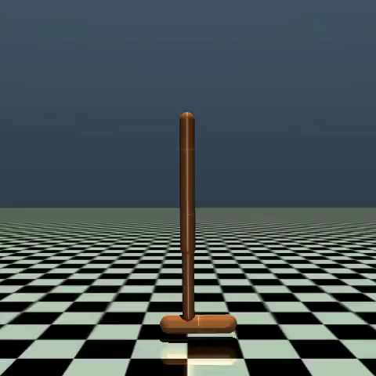
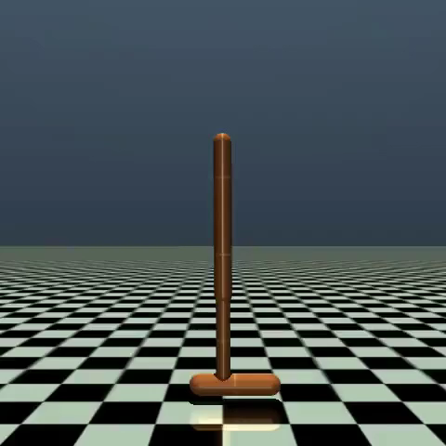

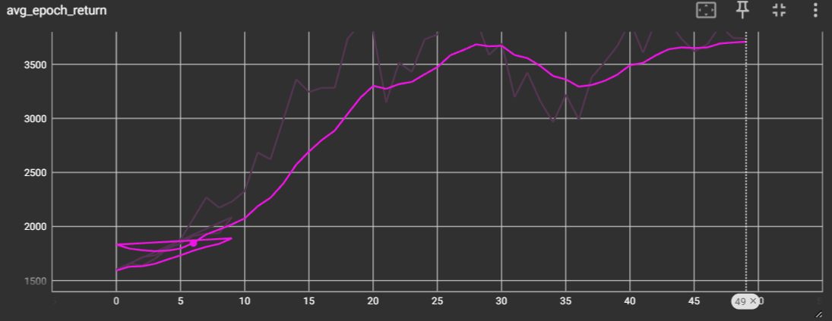
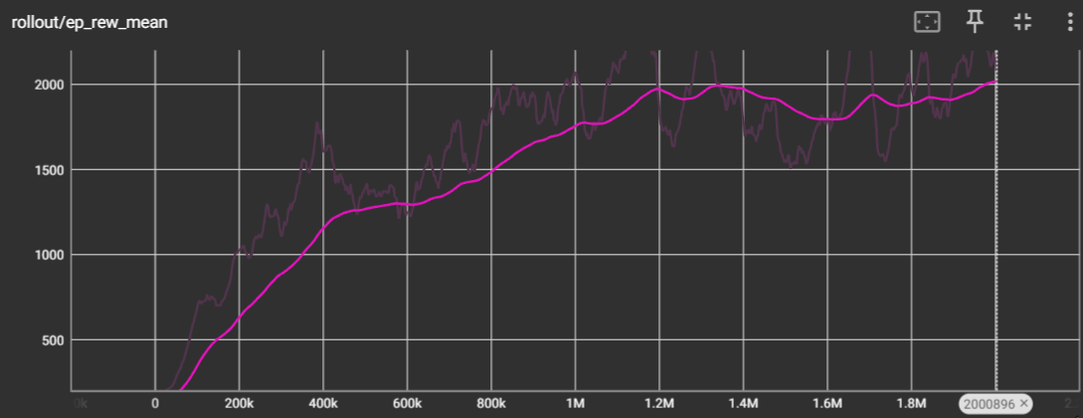
Hopper agents
Our implementation
Stable baselines 3
Standard Implementation doesn‘t work at all
Changing hyperparameters → no improvenment
Implementing some details from → improvement
Successful training and good performance in the complex enviroment
Slightly improvements with more training expected to be possible
default parameters from BaselinesZoo (by DLR) were used

Slide 13
Main differences in the implementations
Recognized a huge difference in performance of the used algorithms, although they follow the same concept → WHY?
Our Implementation:
Use of frozen networks as targets/ baselines
Train the Actor and Critic with different losses
Both networks are independent
Critic: Value Estimation with TD-Learning
Actor: Policy Estimation with Policy-Gradient
Policy (mean and std) are both outputted by the Actor network
Only standardized advantage
Stable Baselines Implementation:
Use of saved variables from the last rollout as baselines instead of frozen networks
Train Actor and Critic with the same combined losses
Both networks are separated, but dependent
Use of entropy and weight factors to weight the different parts of the combined loss
Only the mean of the policy is outputted by the Actor network, std is implemented as a trainable variable
Observations, reward and advantage are standardized
We implemented some features from stable baselines and archieved some improvements on the hopper enviroment.
Combining networks and discarding the frozen nets not implemented because of limited time and computing power.
https://github.com/DLR-RM/rl-baselines3-zoo/tree/master (Abgerufen am 13.01.2024)
https://github.com/openai/baselines/tree/master/baselines (Abgerufen am 13.01.2024)

Slide 15
Overall Conclusions/ Lessons Learned
Conversion of a discrete algorithm to a continuous possibly by changing the policy structure (actor network) and some sampeling methods
Performance depends on small implementation details, not only on the algorithm itself (see hopper)
There are a lot possibilities to implement the same algorithm → huge variablity
Reward Shaping helps to solve difficult environments (with destructive reward)
NaN Issue - for complex environments (e.g. hopper) some of the actor weights became 0
Units get “deactivated”, Adam Optimizer fails and outputs a NaN – value
“Solved” by using leaky_relu instead of relu as activation of the hidden layers (weight = 0 is much less possible)
Avoid calculating a fraction, use log difference instead → better numerical stability
Standardize observations in experience gathering can be crucial, if actions get out of bounds [-1 … 1] to often
Tuning hyperparameters is only for fine-tuning → using defaults worked out to be always the best

Slide 16
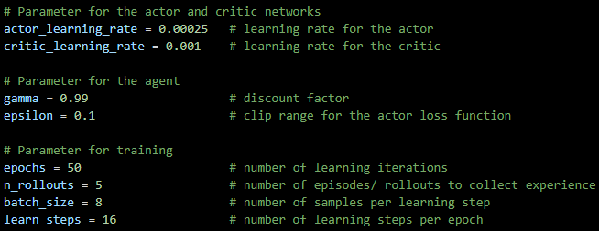
Trainingsparameter Mountain Car

